Slide 1
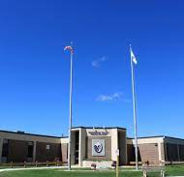
Shawsheen Valley Technical High School Support Services Parent Information Night April 23, 2024
At Shawsheen Valley Technical High School, it is our mission to provide a positive learning experience in a safe educational environment that encourages all students to reach their full potential, emphasizes the value of a strong work ethic, and prepares them for adult life in a competitive world.

Slide 2
WELCOME Class of 2028
Pro
Private School Students
Han
H
Charter Schools Students
Hanscom Students
This Photo by Unknown Author is licensed under CC BY-SA

Slide 3
Mission
At Shawsheen Valley Technical High School (SVTHS), it is our mission to provide a positive learning experience in a safe educational environment that encourages all students to reach their full potential, emphasizes the value of a strong work ethic, and prepares them for adult life in a competitive world.
Core Values
At the heart of our mission is our commitment to preparing students for adult life in a competitive world, which requires a strong work ethic, regardless of the career paths students pursue. For that reason, we determined the need to identify and prioritize core values for the SVTHS community.
Core values define how everyone in our school community will work together to achieve the school’s mission. At SVTHS we have adopted the core values of Accountability, Integrity, and Respect. The core values we selected reflect values that are in demand from employers across all fields and are qualities we believe are essential for all SVTHS students and staff to exhibit.
SVTHS Core Values
Accountability Take responsibility for your words, actions, and commitments. | Integrity Be honest and do the right thing, even when no one else is watching. | Respect Treat everyone the way you wish to be treated.

Slide 4
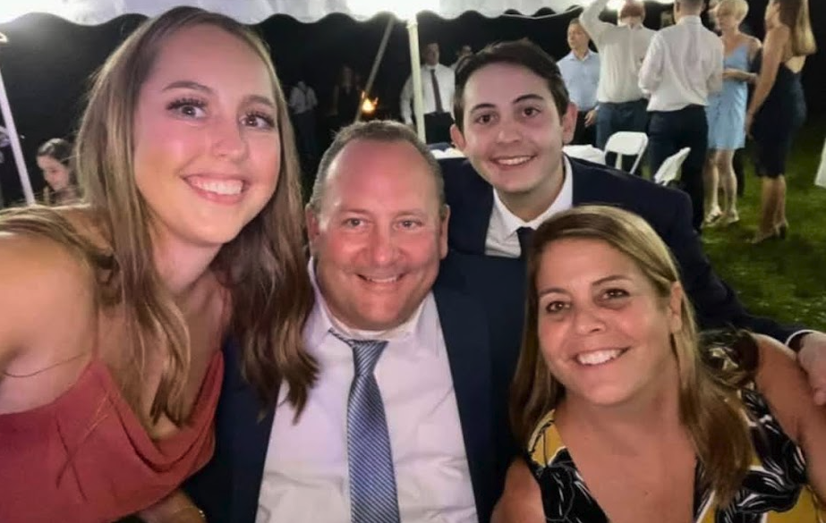
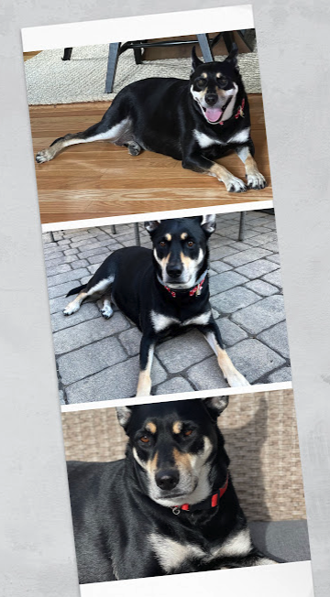
ABOUT Me...
I joined Shawsheen Tech in August 2021 and have accumulated 31 rewarding years of experience working in the field of special education. At this stage, I have programmed for students in PreK-12 districts, vocational-technical school districts, educational collaboratives and adults with disabilities.
The different roles I have worked in:
Special Education Paraprofessional
Special Education Teacher in a K-6 setting
Special Education Teacher in a comprehensive 9-12 setting
Special Education sub-separate program teacher
Inclusion co-teacher
Special Education Team Chair within a 9-12 comprehensive high school
Special Education Team Chair within a vocational-technical school district
Special Education Supervisor within a vocational-technical school district
Special Education Director at Greater Lowell Technical High School
Executive Assistant Director of a Collaborative
Director of Support Services at Shawsheen Technical High School
The broad range of my experience has prepared me for this role. When I am not working, I enjoy spending time with my family, seeing live music, adventuring in the mountains, ocean, and nooks and crannies of the great outdoors in my Jeep Wrangler. When I am not Jeep adventuring, I love driving all over New England in my vintage 1971 Volkswagen camper bus with my rescue dog Sadie as my co-pilot. I like to say that I am puttin’ on miles and creatin’ smiles! I really believe that positive energy is contagious.

Slide 5
Support Services Department
Our Support Services Department is made up of 28 staff members which include:
Director- Jeff Albert (978) 671-3647
Administrative Assistant- Karen Harvey (978) 671-3648
16 Special Education Teachers Contract Services:
2 School Psychologists (one of whom is a .50 Occupational Therapists
Team Chair and .50 School Psychologist) Physical therapists
2 School Adjustment Counselors Vision Specialists
1 Speech Language Pathologist Audiological Specialist
5 Paraprofessionals (none of them provide 1:1 support) Assistive Technology Specialist
Behavior Specialist

Slide 6
Current Support Services Snapshot for the 2023/2024 School Year
Total ST Enrollment : 1281
SWD at ST: 338. Approx. 27%
Grade:
9th: 98 - 30%
10th: 86 - 24%
11th: 88 - 23%
12th: 70 - 23%
IEP’s by town at SVTHS
Bedford: - 30% Special Ed at SVTHS
Billerica: - 32% Special Ed at SVTHS
Burlington: - 35% Special Ed at SVTHS
Tewksbury: - 27% Special Ed at SVTHS
Wilmington: - 26% Special Ed at SVTHS

Slide 7
The student receives an acceptance letter!
What's next?
From the beginning, the Shawsheen Tech application process is a “blind" process. This means that we do not know which accepted students have an IEP. On the application, parents can voluntarily self-disclose, but are not required to tell us if their student has an IEP at the time of application.
After the acceptance letters go out, our Support Services office gets involved to gather student records and organize the IEP transfer process for students.
As a parent/guardian of a student on an IEP, we will request some necessary documents before we can schedule on on-site IEP Transfer Meeting.
Documents required are:
- A current signed IEP
- Copies of the most recent evaluation reports
- Current Report Card
We would like to take a flexible approach and do what works best for students and families. Every student on an IEP coming to Shawsheen Tech will need an IEP Transfer Meeting in-order for a Shawsheen Tech IEP to be developed. Because Shawsheen Tech is its own school district operating under the guidelines of a program school, IEP services can look different from your students’ current IEP.
In an email you will be receiving a link to “Sign-up Genius” to schedule a 30 minute IEP Transfer Meeting. Meetings will be held:
Tuesdays and Thursdays during the month of May from 2:30pm – 4:30pm
Two Saturdays: May 4th and May 18th from 8:00am – 12:00pm
A parent/guardian MUST bring the student to the IEP Transfer Meeting at Shawsheen
If the student is in an out of district placement, then a meeting with the district and parent will be mandatory to look at the appropriateness of placement at Shawsheen.
Note: If a student is in an out of district placement that your current districts team has thoughtfully developed using all the pertinent data points, Shawsheen could be a placement challenge due to the fact that we have to function within the parameters of our program.
Information at the IEP Transfer Meeting is gathered and the Shawsheen Team will send a proposed IEP to you during July or August

Slide 8
Academic Programs
9th GRADE COURSES
 |  | Level | Credits
ENGLISH LANGUAGE ARTS
1011 | Honors Freshman English | 1 | 5.0
1012 | CP Freshman English | 2 | 5.0
1013 | CP Freshman English | 3 | 5.0
1014 | CP Freshman English | 4 | 5.0
1015 | CP Freshman English | 5 | 5.0
9114 | Freshman English* | 5 | 5.0
MATHEMATICS
3010 | Honors Geometry | 1 | 5.0
3011 | CP Algebra I | 2 | 5.0
3012 | CP Algebra I | 3 | 5.0
3013 | CP Algebra I | 4 | 5.0
9312 | Algebra I* | 5 | 5.0
SCIENCE
5011 | Honors Lab Cell Biology | 1 | 5.0
5012 | CP Lab Cell Biology | 2 | 5.0
5013 | CP Lab Cell Biology | 3 | 5.0
9511 | Cell Biology* | 5 | 5.0
SOCIAL STUDIES
2010 | Honors U.S. History I | 1 | 2.5
2011 | CP U.S. History I | 2 | 2.5
9211 | U.S. History I* | 5 | 2.5
4010 | CP 21st Century Civic Literacy (Semester course) | 1 | 1.25
9410 | 21st Century Civic Literacy * (Semester course) | 1 | 1.25
4011 | CP Digital Literacy and Citizenship (Semester course) | 1 | 1.25
9411 | Digital Literacy and Citizenship (Semester course) | 1 | 1.25
PHYSICAL EDUCATION/WELLNESS
6100- 6101 | Physical Education and Wellness Students take one semester of Freshman Fitness and one semester of Freshman Health/Aquatics | 1 | 1.5
CVTE PROGRAM & RELATED THEORY
 | CP Career Awareness, Health & Safety (Terms 1-3) | 1 | 15.0
 | Technology Shop/Lab (Term 4) | 1 | 5.0
TOTAL REQUIRED CREDITS |  |  | 41.5
* Enrollment in this course requires an IEP, TEAM recommendation, and parental consent.

Slide 9
We are Different and we are proud of our program
We have the same 180 days of school, but our program is different from others.
Our 180 days of school is split in half: 90 academic days and 90 vocational-technical day which means that 50% of the time spent here will be devoted to a vocational-technical shop. This leaves half the time to teach the same amount of academic curriculum in preparation of MCAS. The good news??...We do an amazing job with this. All you have to do is to look at our results historically and you will realize that your student is in great hands here at Shawsheen Tech. This is such a great opportunity for students who are ready to experience a Chapter 74 Vocational-Technical Program.
We are an academic leveled program where students are placed with peers that are on a similar academic level, creating the ability for teachers to take a more targeted approach to teaching. What does this mean? We meet students where they are and grow them from there.
We are an inclusive model where our Support Services staff supports students in their academic classrooms. Because we are leveled, our class sizes tend to be much smaller, especially is English, Math, and Science.
With that being said, we want your student to be happy and feel supported here in their program. For the majority of you that had your student apply, a vocational-technical program was absolutely the right choice. If, by some chance you are thinking that your student needs a program with a different purpose and focus, or a program with different IEP services…that’s OK! We want to be sure you are making the best decision for high school based on what the most primary needs of your student are. We can help navigate any questions you may have about this.

Slide 10
Some potential indicators for success within a Vocational-Technical Program
The student has the self-regulation skills and the ability to manage impulsivity in the classroom and in a variety of industrial settings
Based on the sending team’s IEP, the student does not require a life-skills program, therapeutic program, pre-vocational program, language-based program, or specially designed ASD program
The student can independently ride a school bus to school
Student can handle the transition between academic weeks and vocational/technical weeks. It is important to remember that there is a nine (9) day-break in between academic weeks. (a weekend, a shop week, and a weekend)
Student has the ability to complete homework and finish classwork outside of school hours. Due to the 90-day academic schedule, there is shop week homework assigned by the academic teachers so that students can stay in an academic mindset. This makes transitioning back to an academic week a little easier for student. If your student has gotten into the bad habit of not completing homework, that habit is going to have to change here at Shawsheen

Slide 11
IE
INDIVIDUALIZED EDUCATIONAL PROGRAM DETAILS
As an incoming student on an IEP:
The student’s IEP services will start on the first day of school on 9/4/2024. The written IEP will have a start date of 9/4/2024. The Shawsheen IEP will end according to the student’s natural cycle from their previous IEP. Some examples:
IEP cycle: 9/4/2024 – 10/27/2024
IEP cycle: 9/4/2024 – 2/17/2025
IEP cycle: 9/4/2024 – 4/23/2024
All students on an IEP will be assigned a liaison. This person will be a person licensed in Special Education and will serve as the student’s case manager. This is essentially the student and the parent/guardian’s “go-to” for progress updates and any supports needed.
The team at Shawsheen will do the IEP annual review or re-evaluation according to the end dates.
It will be very important for you to send us back the electronically signed IEP by the first day of school so that we can provide the services outlined in the IEP for your student.

Slide 12
Special Education Parent Advisory Council (SEPAC)
The Shawsheen Technical High School Special Education Parent Advisory Council (SEPAC) is an all-volunteer organization of parents of children with disabilities who meet to learn more about Special Education. We host informational meetings and work with all stakeholders on pertinent issues that relate specifically to Special Education.
Purpose​
The purpose of the Shawsheen Technical High School Parent Advisory Council (SEPAC) is to provide information and support to parents of children with special needs. They will work to:​
Advise the Director of Support Services and the School Committee on the operation and development of Special Education programs.​
Establish better understanding and communication between parents/ guardians and school officials.​
Establish a network of support between parents with similar needs.​
Promote communication and programs within the community and to encourage understanding, acceptance and inclusion of children with special needs.​
Provide informational forums to parents, educators, students and professionals involved with children with special needs.​
Membership​
Membership is open to any resident of the Shawsheen Technical High School District of Bedford, Billerica, Burlington, Tewksbury, and Wilmington. Notice of the Special Education Parent Advisory Council (SEPAC) meetings are posted on the school web-site and through a school-wide email notification.​
We welcome your participation! If you are interested in becoming a member or would like more information about the Shawsheen Technical High School Special Education Parent Advisory Council, please contact the Jeff Albert, Director of Support Services at 978-671-3648 or jalbert@shawtech.org. ​

Slide 13
Thank you for attending and welcome To Shawsheen Tech's Ram Family

